Slide 1
Real-Time
Assistive Live Caption
Predictions for Disfluency
By Ranjith Merugu and Ethan Lau

Slide 2
Table of Contents
01
02
03
04
What is the problem?
Motivations for the project
Stuttering disrupts communication.
Assist people with stuttering to speak.
Existing work and proposal
Data and evaluation
SpeakUp, Our methodology
Datasets and evaluations.

Slide 3
01
What is the problem?

Slide 4
What is the problem?
Stuttering disrupts natural communication, causing broken or prolonged speech segments. Existing therapy tools such as Speakup, SLP apps focus on offline training but not real-time communication support.

Slide 5
What is the problem?
Goal: Build a personalized assistive device:
Listen to live speech
Clean and reformat unclear portions of speech
Generate live captions and and/or re-synthesized voice output for fluent communication
Impact:
Real-time accessibility for speech-impaired individuals
Useful for presentations and conversations

Slide 6
02
Motivations behind the project

Slide 7
Motivations behind the project
This project would benefit individuals who struggle with speech impairment.
Our target audience:
Speech-Impaired Individuals (e.g. people with throat cancer recovery)
Elderly individuals who are facing vocal degradation
People who rely on assistive speech devices

Slide 8
03
Existing work and our methodology

Slide 9

Existing work
SpeakUp (ICTer 2019):
Offline training application
Focused on ‘Slowed Reading’ and ‘Easy onset’ training
Uses voice analysis, noise filtering, and syllable counting to address stuttering severity
Achieved ~75-76% recognition accuracy but works only in practice sessions not real-time conversations
Notes:
What type of sensors has been used and how it used?
Microphones, Youtube clips, Facial tracker

Slide 10
Gaps in existing work
Speech construction
Context-aware dialogue generation
No real-time speech construction occurs in SpeakUp
No personalization to the user or emotional adaptation
Incomplete Speech
Currently no integration with ASR or LLM to produce readable captions

Slide 11
Our Direction
Move from therapy to assistive real-time communication.
Overview:
ASR with noise and stutter detection
Personalized speech model
Live caption display and an optional, synthetic clean voice

Slide 12
Our solution
Stages:
Audio Capture and Preprocessing
Speech Enhancement
Speech-to-Text Captioning
Personalization Module
Display and Output

Slide 13
Audio Capture and Preprocessing
Overview:
Involves retrieving the live microphone input
Detecting stutters and filtering noise out using pause detection and syllable repetition features
Convert the raw waveforms → a stream of clean speech
We used a PyTorch Silero-VAD (lightweight DNN voice-activity detector) to segment real-time audio stream into speech chunks and remove silence

Slide 14
Speech Enhancement
Overview:
Removes prolongations (i.e. “ssss”), repetitions (“wa-wa-water”), and fills in the gaps in speech
We used DeepFilterNet, a pytorch block to remove clean up audio (A denoise filter)

Slide 15
Speech-to-Text Captioning
Overview:
Real-time ASR (i.e. Whisper’s small model)
Integrates with the preprocessed, clean audio for producing caption stream with low latency (< 1 second)
Adds necessary punctuation and word confidence tags
Our Approach:
Dense Prediction Head -> Confidence Refinement Layer -> Clean Caption Decoder
Dense Prediction Head : Whisper + Bidirectional LSTM -> Outputs (Binary Logit, keep or delay the token)
Confidence Refinement Layer : 1D CNN + Dense layer -> (frame-aligned confidence scores)
Clean Caption Decoder : Lightweight edit-predictor GRU (1×128) that learns token-level edit actions
Keep, Delete-Repeat, Delete-Filler, Merge-Prolong
Notes:
(capture micro-temporal patterns (repeated onsets, blocks, filler bursts) that Whisper’s coarse frame stride misses.)
Outputs frame-level logits over subword tokens + a disfluency gate gt∈[0,1]gt​∈[0,1] that estimates whether to keep or delay the token.
Produces smoother, frame-aligned confidence scores, allowing earlier token emission and fewer dropped repetitions -> Confidence Refinement Layer

Slide 16
Personalization Module
Overview:
Tracks each user’s unique stuttering profile
  Average syllable rate
  Typical pause length
  Frequently occurring phoneme repetitions (involuntary repetition of one’s phrases)
Adapts the speech-cleaning and ASR thresholds per each user over time
Notes:
HeardAI Dataset

Slide 17
Display and Voice Output
Overview:
Captions are then displayed in readable text
An additional option of clean, synthesized voice utilizing text-to-speech
Multiple modes:
  Private caption generation mode (for self-use)
  Speaker mode (for the audience)

Slide 18
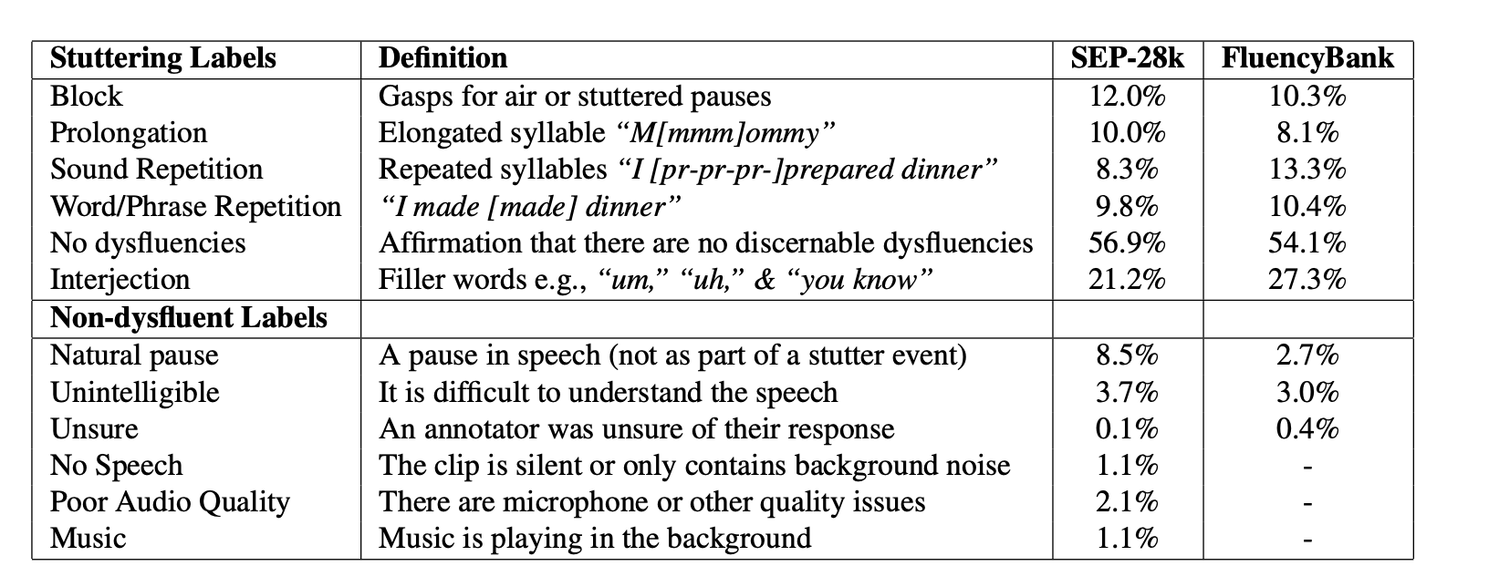
Datasets

Slide 19
Evaluating our method and challenges
 | Baseline (ASR) | Our system with (Sep-28k Fine Tuning)
ASR Accuracy on Stuttered Speech : WER ↓ (SEP-28k) | 29.6 | 18.4 (−37.8% reduction in error)
Latency of system | 2 seconds (for processing 1.2 sec audio) | 2.4 seconds (for processing 1.2 sec audio)
Once we have personalisation ready for this system, we shall have metric as “Mean delay from speech to caption” and stability check (% tokens not rewritten after first display).
Notes:
Diarization Error Rate = (Missed speech (MS)+False alarm (FA)+Speaker confusion (SC) )/ Total reference speech
false alarm (FA) is the time your system claims there is speech when the reference says there is none
Missed Speech(MS) -> Expected vs output
Speaker Confusion(SC) ->
Normalized per speaker.
Focuses on overlap quality rather than raw duration error.

Slide 20
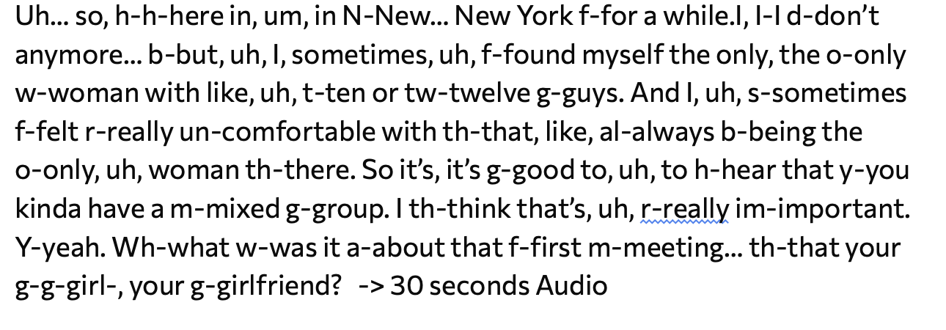
Latency Issues
Current Model output: -> Takes 36 seconds to generate below clean audio
here in New York for a while. I don't anymore. But I sometimes found myself the only woman with like 10 or 12 guys and I sometimes felt really uncomfortable with that, like always being the only woman there. So it's good to hear that you kind of have a mixed group. I think that's really important. Yeah. What was it about that first meeting that your girl, your girlfriend?

Slide 21
Milestones
Nov : 1 - 10 Collect Personalised data (2 - 3 people) also use GPT.
Nov: 11 - 15 FineTune ASR + LSTM with collected data.
Nov: 16 - 26 Create Android App with system
Nov: 27 - Dec 3 : Take user feedback for final report.

Slide 22
Thank You

